Slide 1
E-BIRTH CERTIFICATE
GROUP NO:6
SWATHI LAKSHMI SAHAL P S SOORYA S SREEJITH K M ARUNDHATHI B

Slide 2
INTRODUCTION:
This is a web application that manages, stores, and retrieves Birth Certificates. This application allows certain organizations to manage their members' Birth Certificates. The application was developed using PHP and MySQL Database Free. It has a pleasant user interface and consists of user-friendly features and functionalities. This Online Birth Certificate Management System has 2 types of user roles which are the Administrator and the Users. Both users are required to log in with their valid system credentials to gain access to the features and functionalities of the said system.
The Administrator user is the one who is in charge of managing all the records on this PHP Project. On the Admin Site, the administrator can list, manage, and update members' birth details or records. The admin can also generate the list of the applications between dates they wanted. He/She can also find the records of a certain person only by entering the Application Number.
Users can create their system account by filling in all the required fields on the Registration Page. After the successful registration, the system requires the users to log in by entering their mobile number and password. The normal users are the ones who can register the application of the members. He/she can also list all the members' records that he/she added to the system. The users can also view the printable Birth Certificate of the member.

Slide 3
ABSTRACT
This is a web application that manages, stores, and retrieves Birth Certificates. This application allows certain organizations to manage their members' Birth Certificates. The application was developed using PHP and MySQL Database Free. It has a pleasant user interface and consists of user-friendly features and functionalities.
MODULES:
Admin Panel
Dashboard
Birth Records
List All New Records or Applications
List All Verified Records or Applications
List All Rejected Records or Applications
List All Records or Applications
Generate a Date-wise Report
Search Record
Manage Profile
Update Password
Login and Logout

Slide 4
Users
Home Page
Register New Birth Application
List All Registered Applications or Records
List Certificates
View Certificate
Print Certificate
Manage Profile
Update Password
Signup ▪ Forgot Password
Login and Logout

Slide 5
SYSTEM CONFIGURATION :
HARDWARE REQUIREMENT
System : Pentium Dual Core
Hard Disk : 120 GB
Monitor : 15’’ LED
Input Devices : Keyboard, Mouse
RAM : 2GB
SOFTWARE REQUIREMENT
Operating system : Windows 7/8/10
Tools : Notepad++ (Editor/IDE) , Xamp
FRONT END SOFTWARE
HTML: HTML is used to create and save web document. It specifies layout and linking commands present in the hypertext document themselves the word hypertext refers to the nonlinear information on the document, which helps to navigate through the pages. E.g., Notepad/Notepad++, Dreamweaver

Slide 6
CSS: (Cascading Style Sheets) Create attractive Layout.CSS describes how HTML elements are to be displayed on screen, paper, or in other media. It can control the layout of multiple web pages or advance of external style sheets are stored in CSS files. It is designed to enable the separation of presentation and content including layout, colors and fonts.
JavaScript: It is a programming language, commonly used with web browsers. JavaScript is a high level, interpreted scripting language that conforms to the ECMA script specification. JavaScript has curly bracket syntax, dynamic typing, prototype-based object orientation and first-class functions. It enables interactive web pages and is an essential part of web application.
BACKEND SOFTWARE
MySQL: MySQL is a database, widely used for accessing querying, updating, and managing data in databases. It is a freely available open-source relational database management system that uses Structured Query Language (SQL). It is the most popular language for adding, ascending and man aging contents in a database. It is most noted for its quick processing, proven reliability, ease and flexibility of use.

Slide 7
PHP: Hypertext Pre-processor (PHP) is a technology that allows software developers to create dynamically generated web pages, in HTML, XML, or other document types, as per client request. PHP is open-source software. It is a server-side scripting language that is used to develop static websites or dynamic websites or applications. They can only be interpreted on a server that has PHP installed in it. A PHP file contains PHP tags and ends with the extension “.php”.

Slide 8
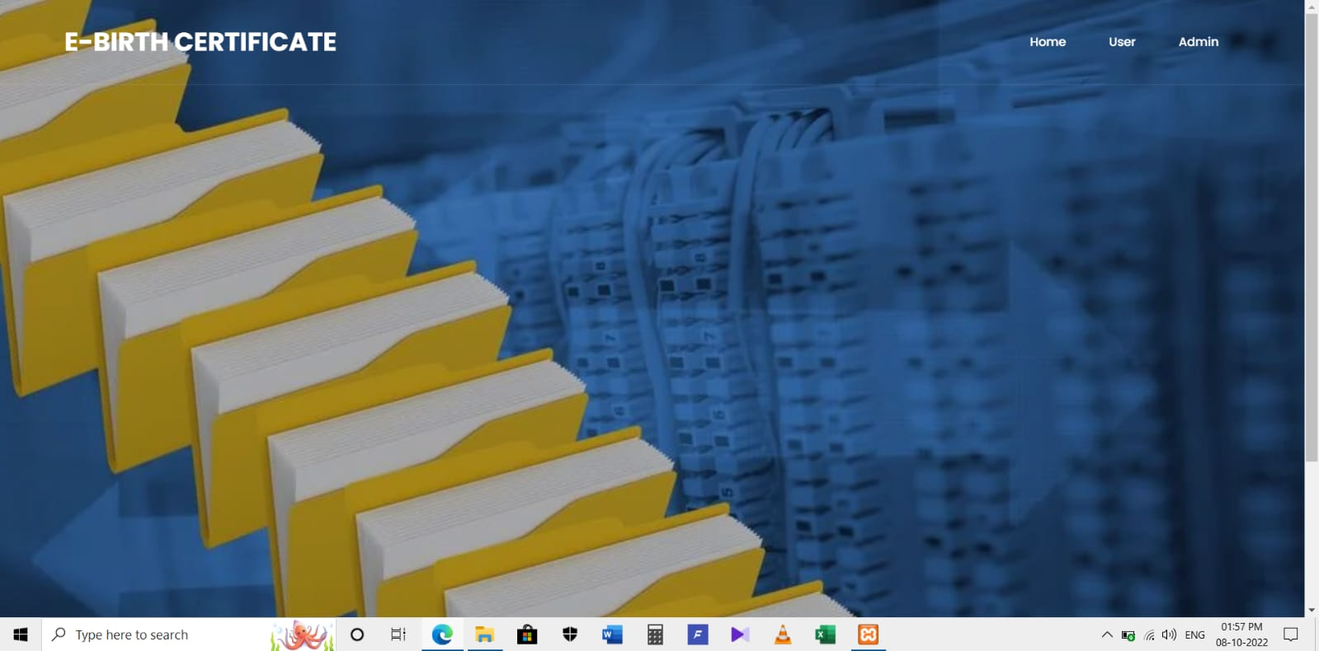
HOME PAGE

Slide 9
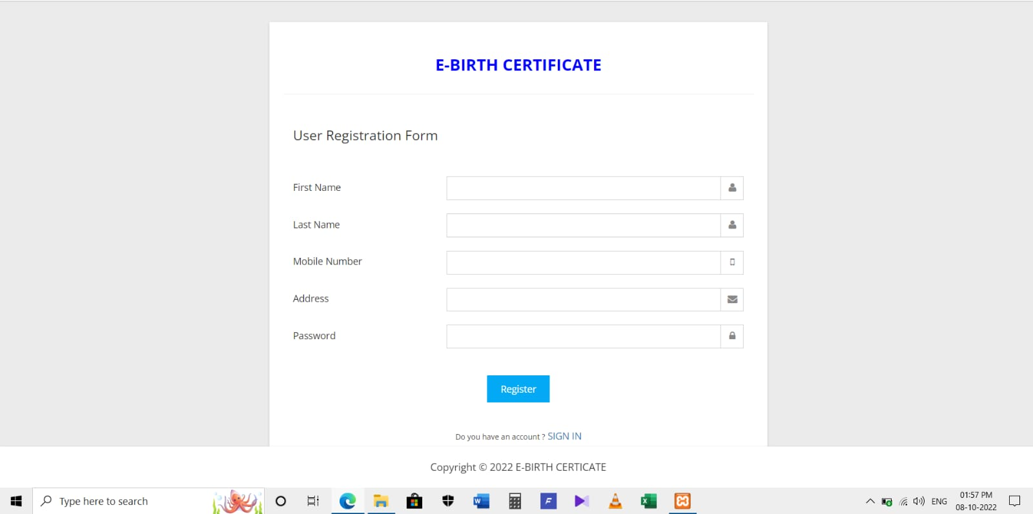
USER REGISTRATION FORM

Slide 10
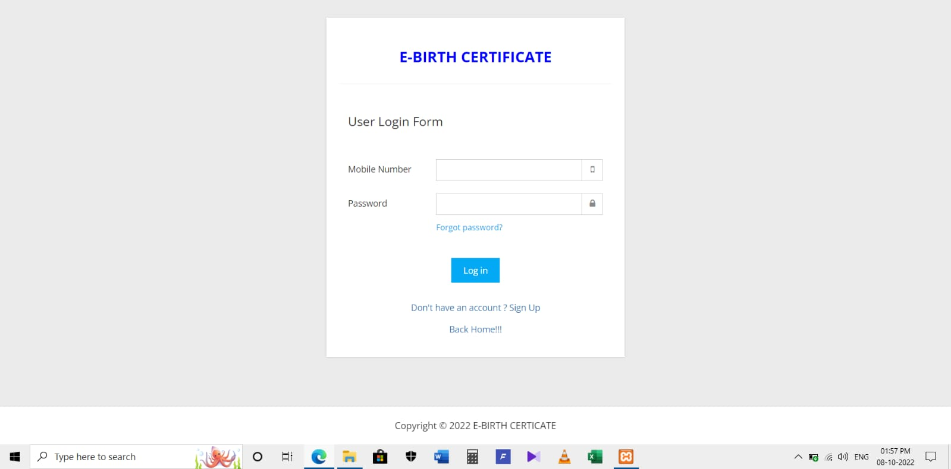
USER LOGIN FORM

Slide 11
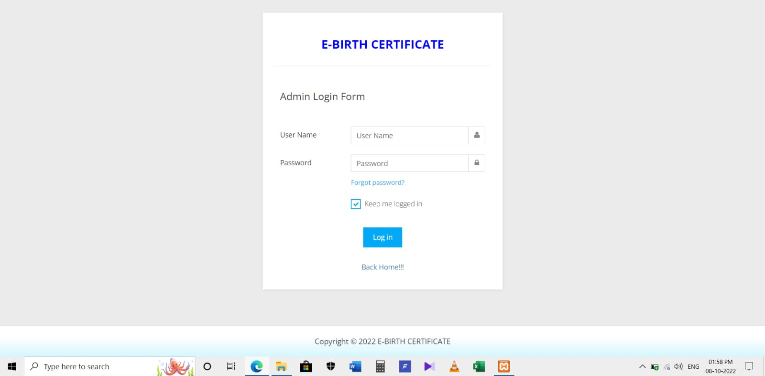
ADMIN LOGIN FORM

Slide 12


